Slide 1
Themes in The Outsiders

Slide 2
What is a theme?
A theme is a main idea or an underlying meaning of a literary work, which may be stated directly or indirectly.

Slide 3
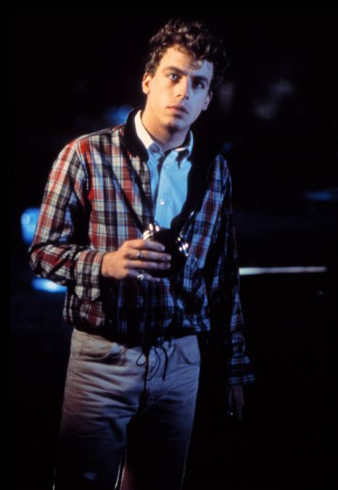
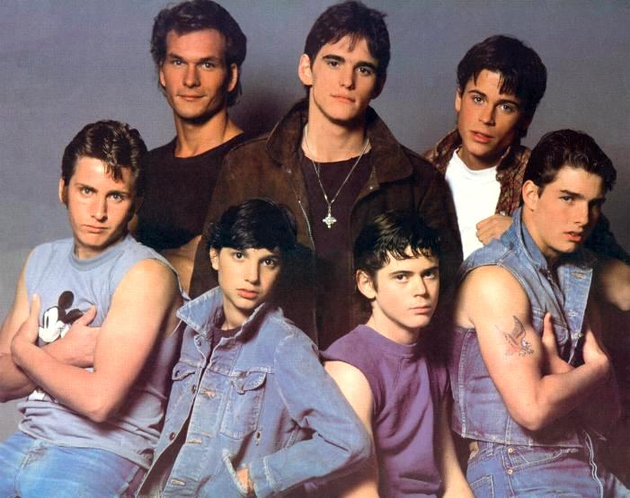
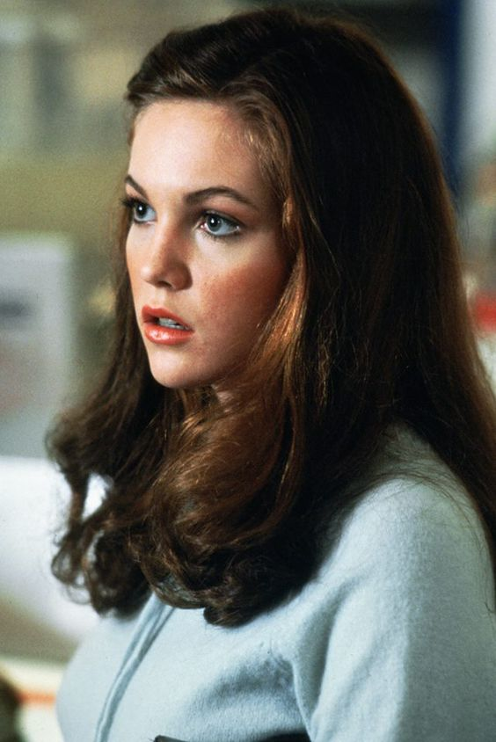
Things are rough all over.

Slide 4
Nothing gold can stay. Change will come, so it’s best to hold on to what you value in life

Slide 5
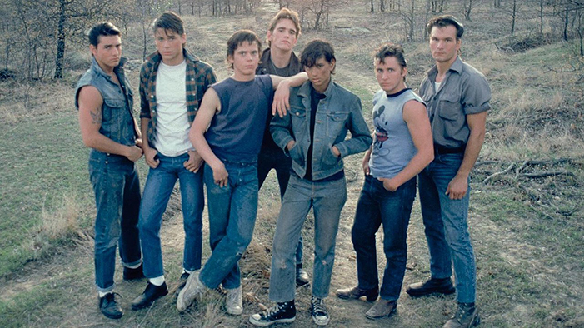
There is honor even among the lawless.

Slide 6
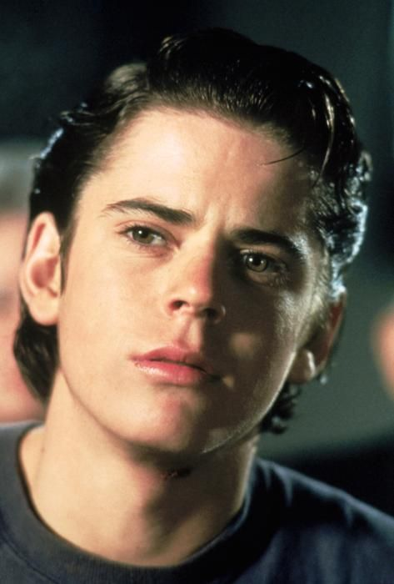
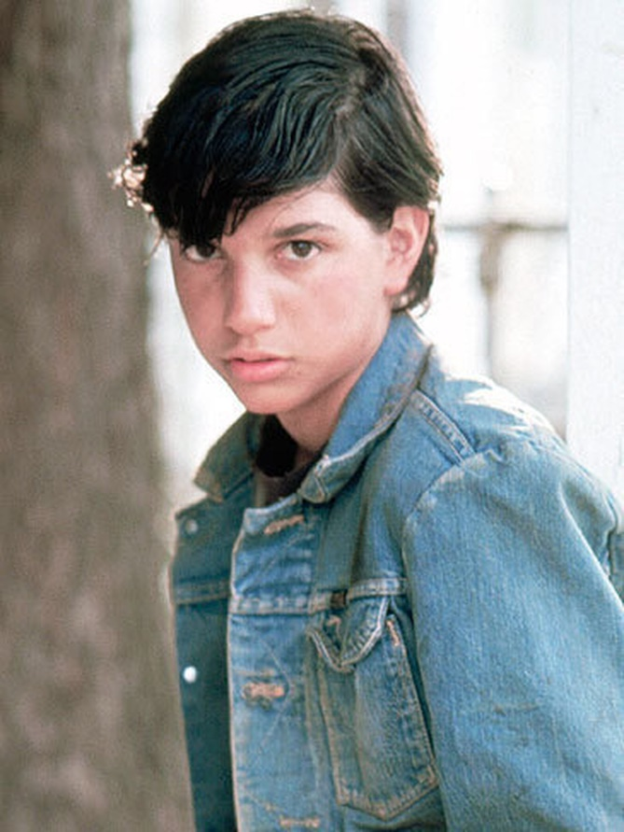
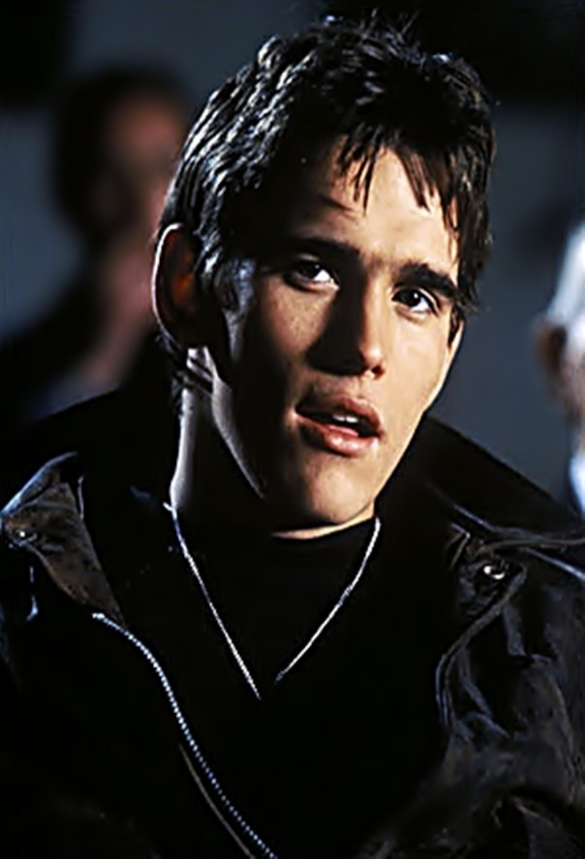
Bravery comes in many shapes and sizes.

Slide 7
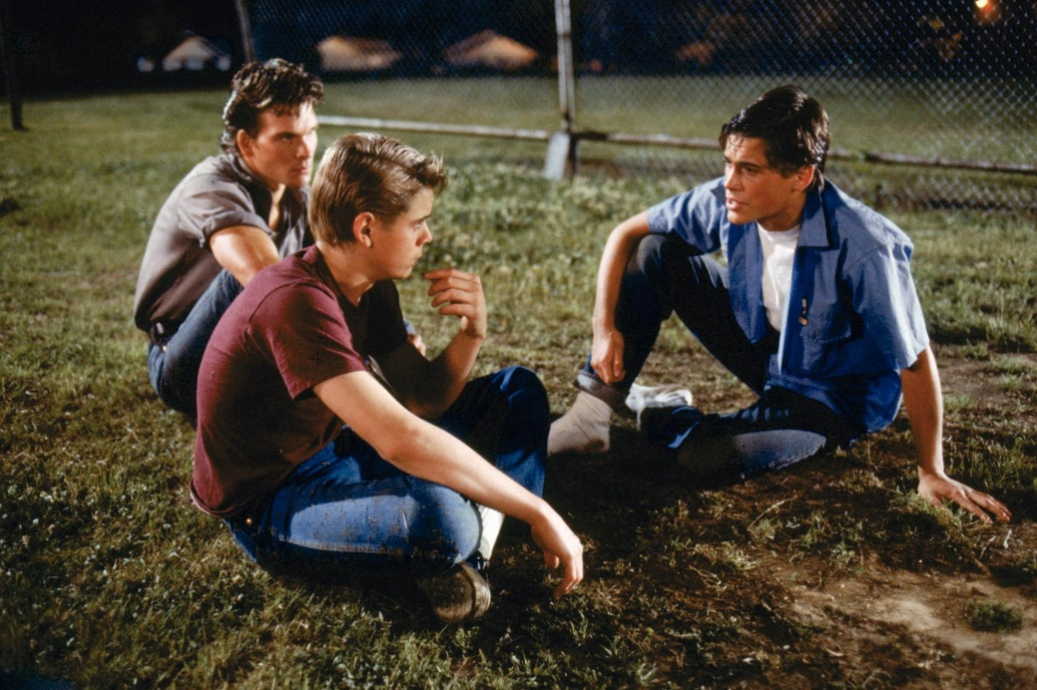
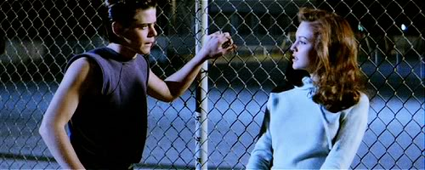
Communication is better than violence. Violence always has negative consequences.

Slide 8
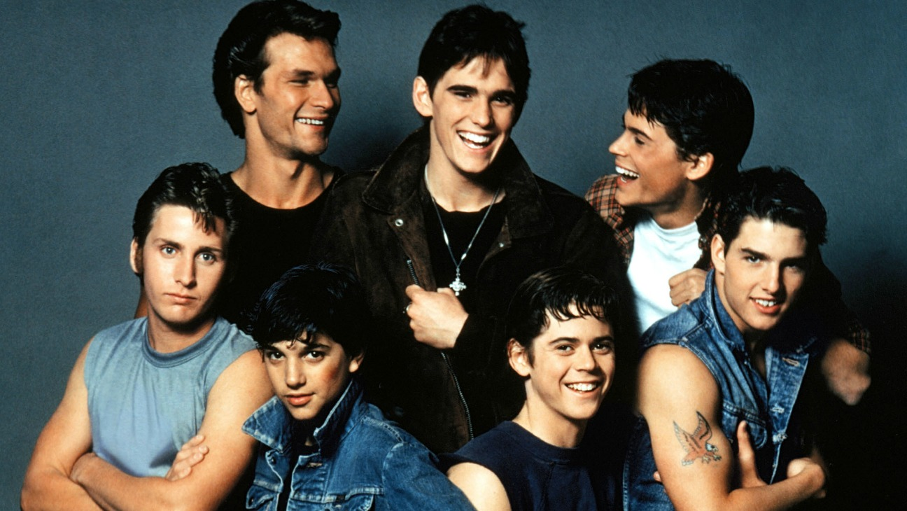
You decide how to survive or thrive in the harsh realities of life.

Slide 9
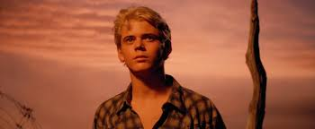
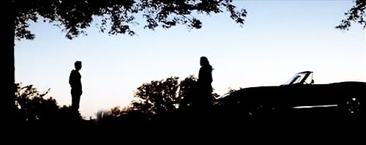
No matter how different we are, we all watch the same sunset. We have something in common.

Slide 10
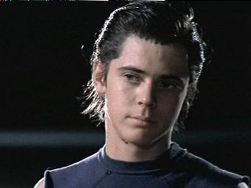
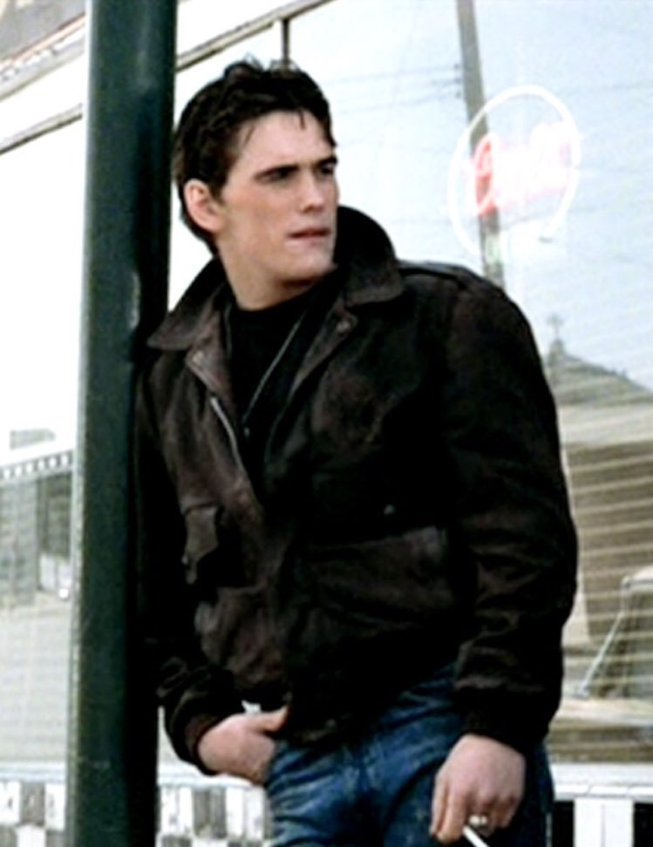
Everyone may feel like an outsider at times.

Slide 11
Growing up is hard, but it’s good in the long run.

Slide 12
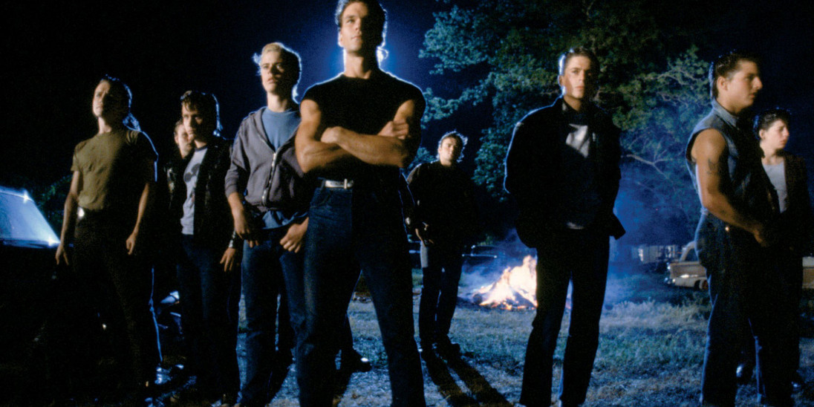
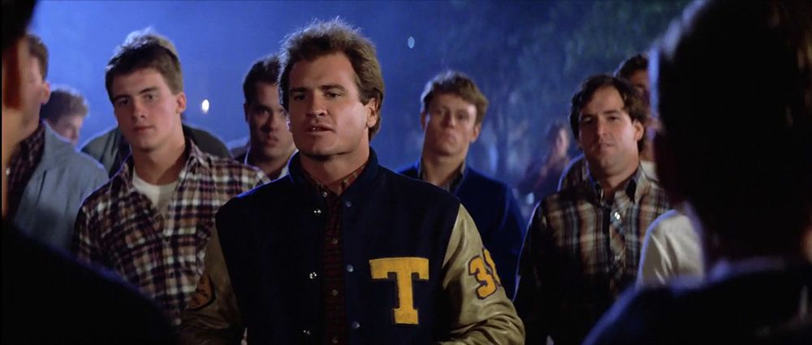
Stereotypes can cause problems.

Slide 13
What other themes could we find in the novel?

