Slide 1
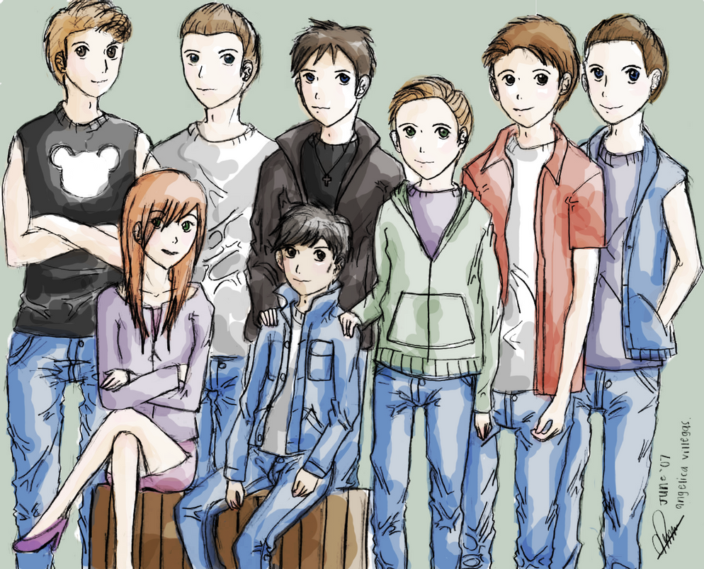
The Outsiders Characters:
Type The Character Name Here

Slide 2
What Is The Significance of The Character’s Name

Slide 3
What Is The Significance of The Character’s Name?
And here goes your text.

Slide 4
Who Does The Character Hang Out With?

Slide 5
Who Does The Character Hang Out With?
And here goes your text.

Slide 6
What Does The Character Look Like?

Slide 7
What Does The character Look like?
And here goes your text.

Slide 8
What Is The Character’s Personality?

Slide 9
What Is The Character’s Personality?
And here goes your text.

Slide 10
What Are The Character’s Actions?

Slide 11
What Are The Character’s Actions?
And here goes your text.

Slide 12
What Do Others Say or Think About The Character?

Slide 13
What Do Others Say or Think About the Character?
And here goes your text.

Slide 14
How Has The Character Changed Over The Course of The Novel?

Slide 15
How Has The Character Changed Over The Course of The Novel?
And here goes your text.

Slide 16
How Do Others View The Character at The End of The Novel?

Slide 17
How Do Others View The Character at The End of The Novel?
And here goes your text.

