Slide 1
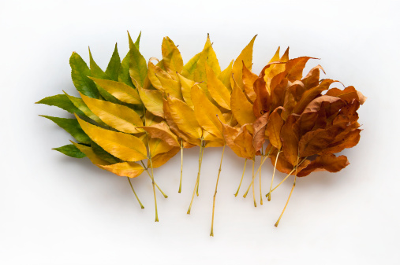
Nothing Gold Can Stay.
By Robert Frost

Slide 2
NOTHING GOLD CAN STAY
Nature's first green is gold,
Her hardest hue to hold.
Her early leaf's a flower;
But only so an hour.
Then leaf subsides to leaf.
So Eden sank to grief,
So dawn goes down to day.
Nothing gold can stay.
-Robert Frost

Slide 3
NOTHING GOLD CAN STAY
Nature's first green is gold,
What does "nature's first green” mean?
Why is it "gold"? Do you think Frost means the color gold? What else could gold symbolize/represent?

Slide 4
NOTHING GOLD CAN STAY
Her hardest hue to hold.
What is a "hue"?
Do you think nature has a hard time "holding" onto green? Why?

Slide 5
NOTHING GOLD CAN STAY
Her early leaf's a flower;
But only so an hour.
What would an "early leaf" be?
Why is it only that way for an hour? Is it really an hour? What is Frost saying here?

Slide 6
NOTHING GOLD CAN STAY
Then leaf subsides to leaf.
So Eden sank to grief,
What does the word "subsides" mean?
What is "Eden"?
What do you think is meant by the reference to "grief"?

Slide 7
NOTHING GOLD CAN STAY
So dawn goes down to day.
Nothing gold can stay.
We don't typically think of dawn, or a sunrise, as "going down", as we would with dusk. Why do you think Frost worded it like this?
What is meant by "nothing gold can stay"?

Slide 8
NOTHING GOLD CAN STAY
Nature's first green is gold,
Her hardest hue to hold.
Her early leaf's a flower;
But only so an hour.
Then leaf subsides to leaf.
So Eden sank to grief,
So dawn goes down to day.
Nothing gold can stay.
Why do you think Frost chose to use the words in red?
What do they indicate to you?

Slide 9
FINAL THOUGHT
Do you think the message of this poem could apply to more than nature? What does it say about people and life in general?
The Outsiders
S.E. Hinton

